Slide 1

#13 Roman to Integer
Akhtamov Azimjon 2024299010
2025-01-16

Slide 2
Problem Definition (1)
Source: Leetcode
Title: Merge Intervals
Difficulty: easy
Type: Hashmaps

Slide 3
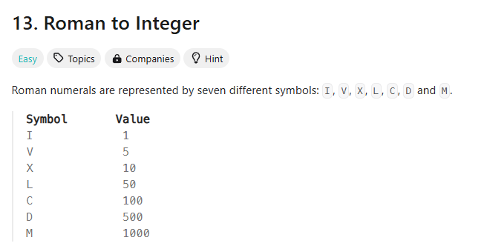
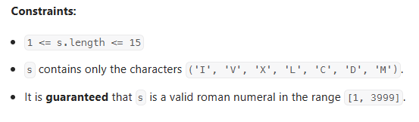
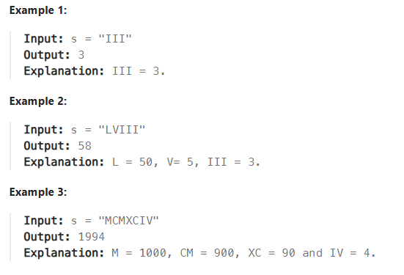
Problem Definition (1)

Slide 4
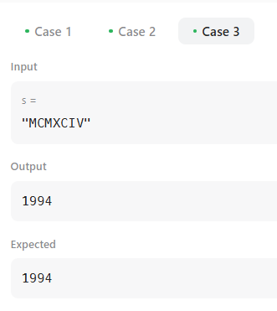
Solution (1)
1000
100
1000
10
100
1
5
M C M X C I V
i
i+1
i+2
...............
i+n
n = Length of string (input)
C M
M - C
i + 1 < i + 2

Slide 5
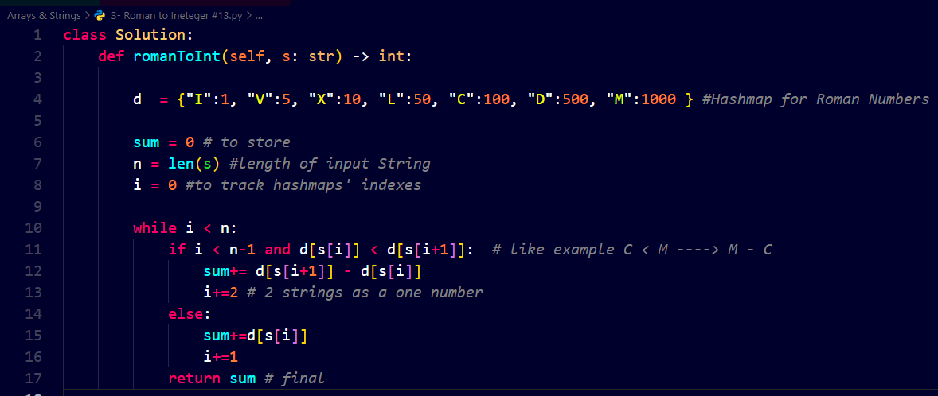
Solution (2)

Slide 6

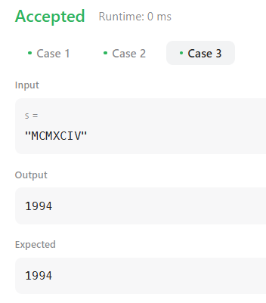
Solution (3)

Slide 7
What I have learned
Hashmaps:
I learnt to check Hashmap’s elements by its indexes
Understood logic of Roman Numbers for CM, IV, IX, XL cases
I used n operators(times) , so ------> time: O(n)
I didn’t use space , so -------> space: O(1)

Slide 8
Questions and Answers

Slide 9
Greetings

